Slide 1

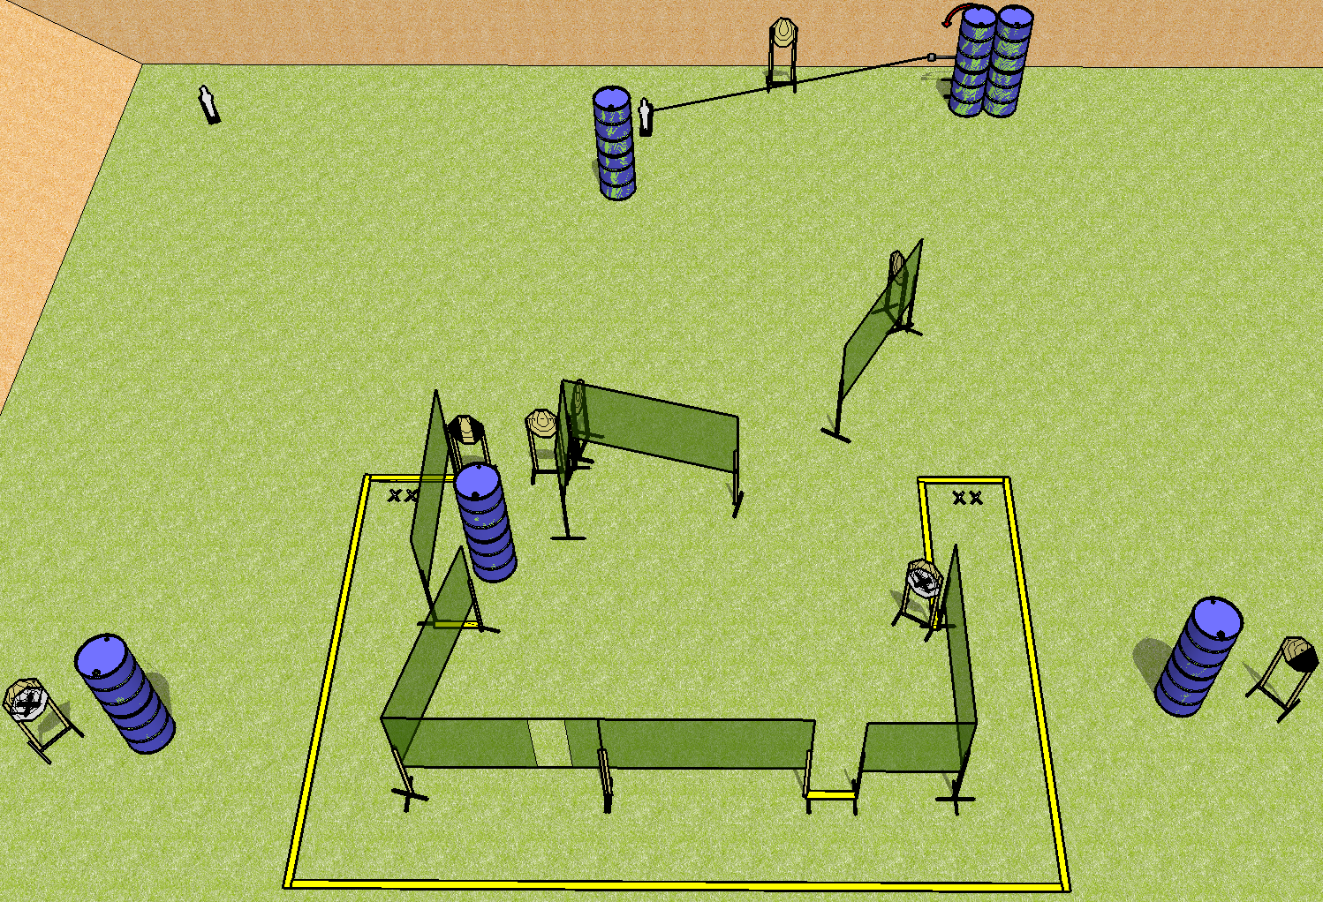
 | Dothan Practical Shooters – USPSA Match U Showdown Course Designer : Drew Coleman Bay: A2
Round Count 20 9 IPSC 2 mini poppers
Equipment List 15 wall feet 1 swinger + activator 1 left diag, 1 tux 9 targets (7 + 2NS)

Slide 2
U Showdown
Written Stage Briefing
Scoring: Comstock Rounds: 20
Targets: 9 IPSC, 2 steel
Handgun start position: feet on either set of X’s, wrists below belt. Handgun is loaded and holstered.
PCC start position: feet on either set of X’s, stock on belt. Loaded carbine is held with both hands, safety on.
Stage Procedure: on the audible start signal, engage targets as they become available from within the shooting area.

